Slide 1
Wireless communications
Adaptive Beamforming
Luca Ferraro, Bernardo Camajori Tedeschini, William Colombo
A.Y. 2020 - 2021

Slide 2
Aim of the project
The aim of the project is comparing the performance of different types of beamforming techniques.
In order to do so, we have made three main simulations:
SNR in-out Comparison for different beamformers
Costellation revealed, array pattern functions and BER for different beamformer and different numbers of antennas
Tracking of 2 vehicles in a multipath environment with LMS beamformer in frequency domain

Slide 3
What we have done
We have implemented:
5 beamformers:
Simple
Null-steering
MVDR
LMS (time and frequency domain)
MMSE
3 Channels:
LOS
2-Ray
QuaDRiGa
Signals:
Constellations: 4-QAM and 16-QAM (results only for 4-QAM)
Transmission: OFDM

Slide 4
SNR in-out comparison: steps of the simulation
Definition of scenario, signals, antenna arrays, variables and parameters
Defining current number of interferents
LOS channel
Looping for different input SNR
Plot of input-output SNR
Computation of antenna weigths
Computation of output SNR
Computation of powers
Signals through beamformers

Slide 5
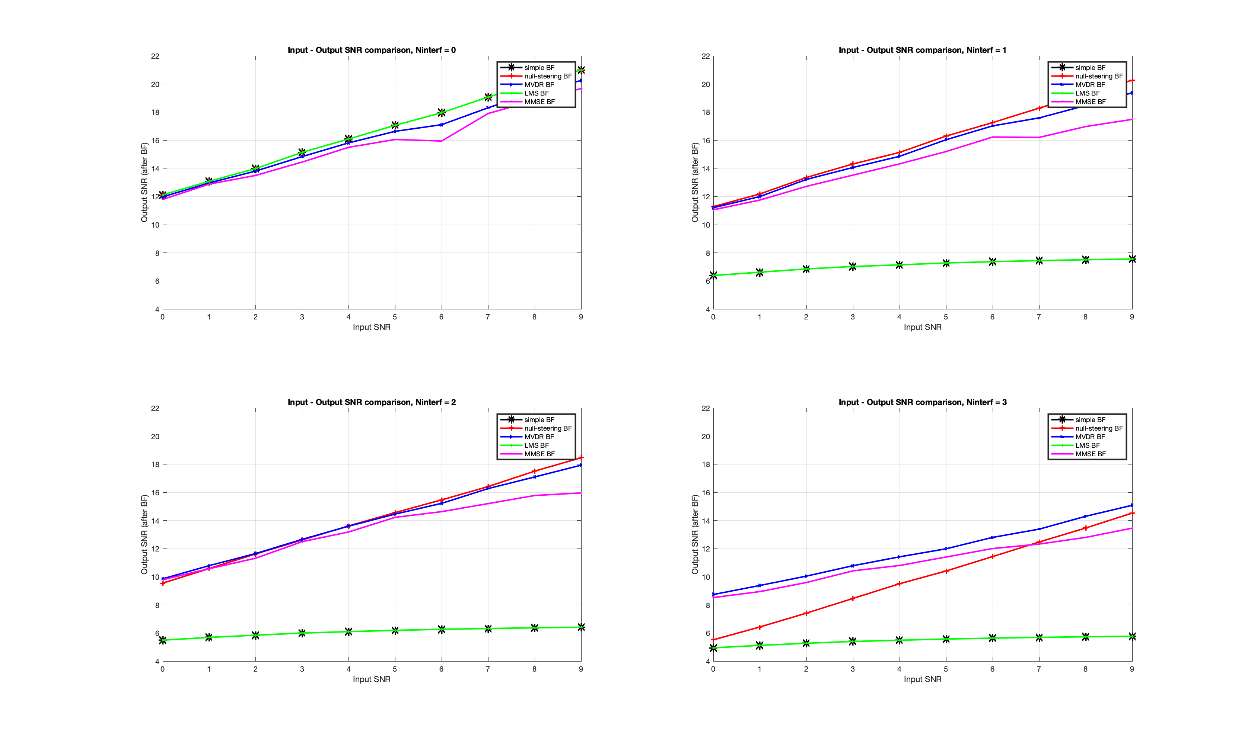
SNR in-out comparison: results

Slide 6
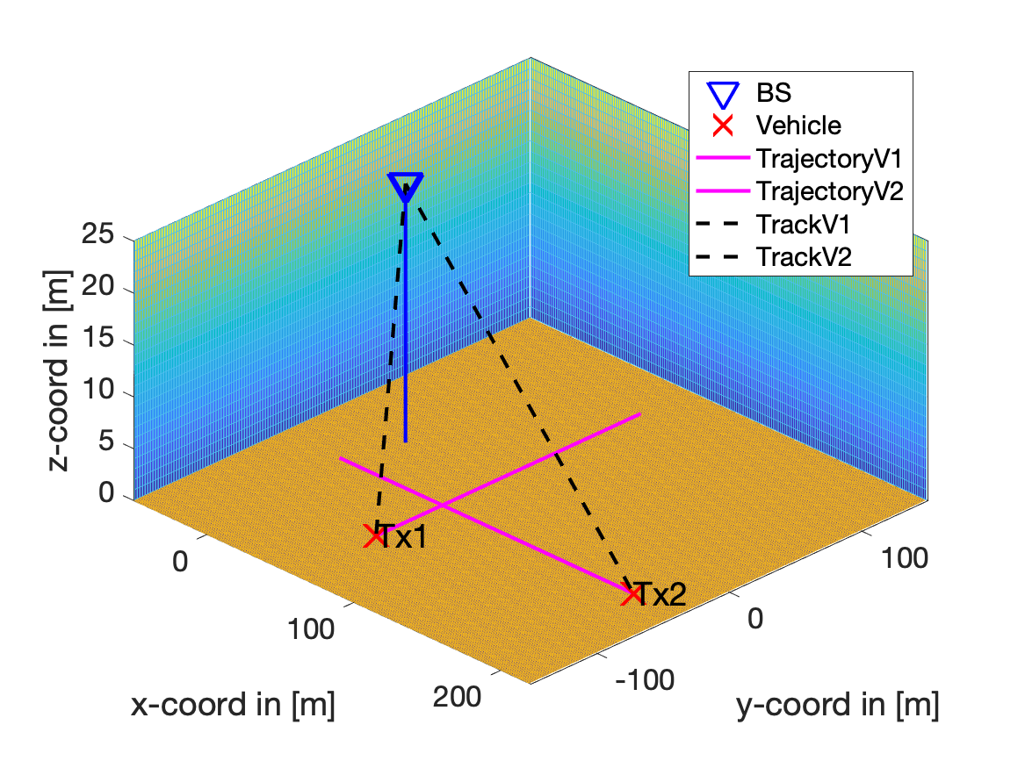
Antenna array comparison: scenario
Usage of 4 different antenna arrays:
2x2
4x4
8x8
16x16
For each antenna array, we show for all the 5 beamformers:
Constellations revealed
Array pattern function
BER
Scenario with 2 fixed vehicles: Tx1 as source, Tx2 as interferent → We want to recovery the signal from Tx1 with an interfering signal coming from Tx2

Slide 7
Antenna array comparison: steps of the simulation
Definition of scenario, signals, antenna arrays, variables and parameters
Get current antenna array
QuaDRiGa channel
Beamforming
BER computation
QAM and OFMD demodulation
Equalizer
(1-taps)

Slide 8
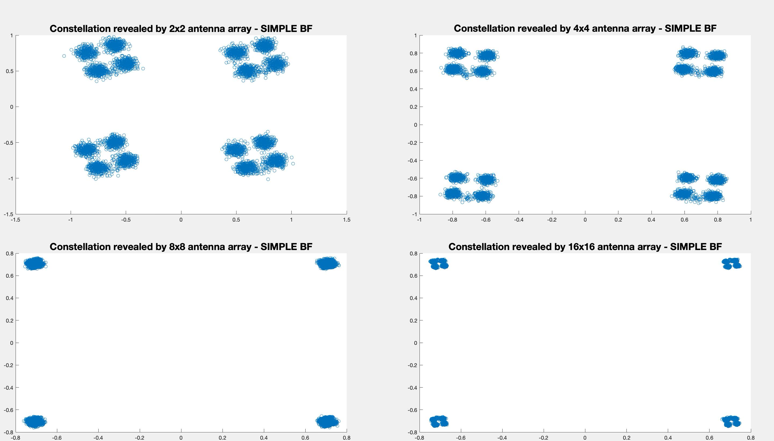
Antenna array comparison: constellations revealed

Slide 9
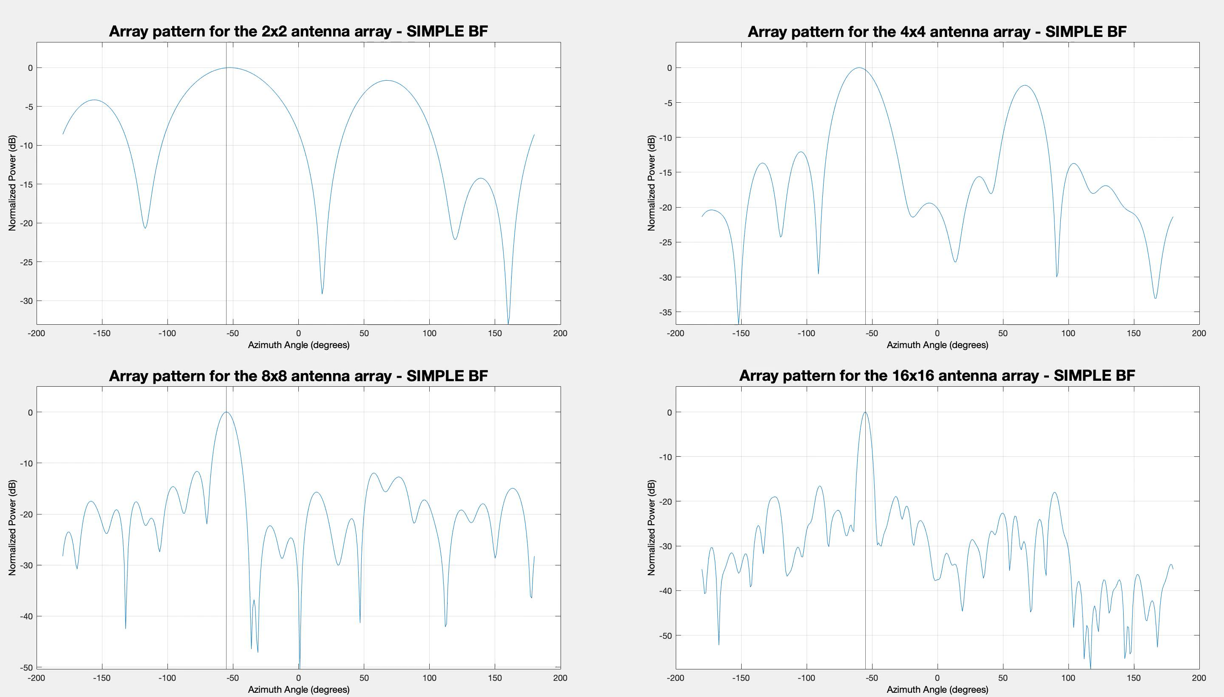
Antenna array comparison: array pattern functions

Slide 10
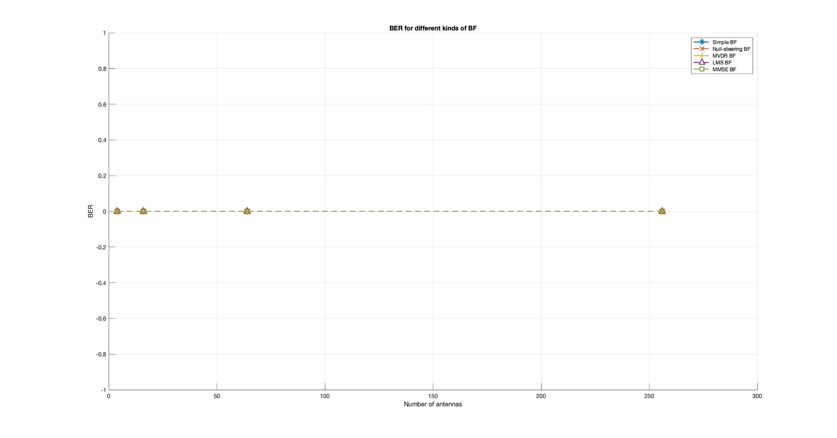
Antenna array comparison: BER

Slide 11
Tracking of 2 vehicles: QUADRIGA channel, OFDM signal, LMS beamforming (frequency)
Parameters:
16x16 Antenna Array
LMS Beamformer in Frequency Domain
OFDM with 4- QAM
64 sub-carrier
24 packets and 100 symbols/packet
Fc = 2.6 GHz
Scenario with 2 moving vehicles at 60 km/h: Tx1 towards Nord starting at x =(70, -100, 1.5)
and Tx2 towards Est starting at x =(200, -50, 1.5)

Slide 12
Tracking of 2 vehicles: steps of the simulation
Definition of scenario, signals, antenna arrays, variables and parameters
Update Positions
Generation of Signals
QuaDRiGa
channel
BER computation
DoA
estimation
QAM demodulation
Equalizer
(1-tap)
FFT and LMS Beamformer

Slide 13
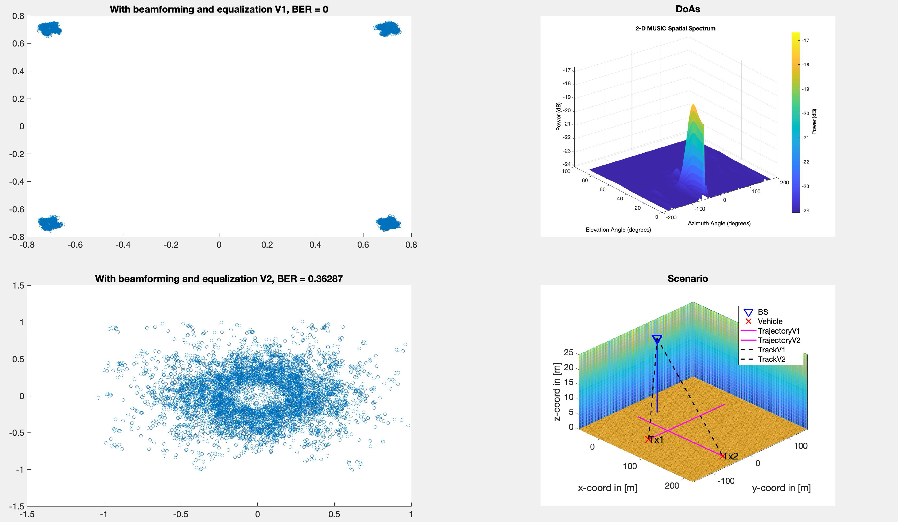
Tracking of 2 vehicles: results

Slide 14
Conclusions
What we have learned:
Understood the potentials of beamforming techniques
Use beamforming for source isolation in environments full of interferents
Our difficulties:
Conversion of physical formulas into Matlab language
Interpretation of physical meaning of the results
Future developments:
Massive MIMO

